Slide 1
Mood disorders and Suicide
Week 7

Slide 2
The two key mood disorders
Mania: characterized by intense and unrealistic feelings of excitement and euphoria
Depression: usually, feelings of extraordinary sadness & dejection
Types of Mood Disorders:
Unipolar depressive disorder: only depressive episodes
Bipolar disorder: the person experiences both manic and depressive episodes
Differentiate among the mood disorders in terms of,
(1) severity —the number of dysfunctions experienced and the relative degree of impairment evidenced in those areas;
(2) duration —acute, chronic, or intermittent (with periods of relatively normal functioning between the episodes of disorder).

Slide 3
Depressions That Are Not Mood Disorders
LOSS AND THE GRIEVING PROCESS
To be more difficult for men than for women
Bolwlby´s theory: our phases of normal response to the loss of a partner or close family member:
Numbing and disbelief,
yearning and searching for the dead person,
(3) disorganization and despair that sets in when the person accepts the loss as permanent, (4) some reorganization as the person gradually begins to rebuild his or her life.
Symptoms and impairment following other important losses (e.g., marital dissolution, unexpected economic misfortunes, or job loss) are virtually identical to those seen during bereavement.

Slide 4
POSTPARTUM “BLUES” (they are very common:50-70%)
Symptoms: changeable mood, crying easily, sadness, and irritability, often liberally intermixed with happy feelings (even hypomanic symptoms)
A greater likelihood of developing major depression after the postpartum blues
Adverse effects on child outcomes
Why? Hormonal readjustments and alterations in serotonergic and noradrenergic functioning
Especially likely to occur if
  the new mother has a lack of social support
  or has difficulty adjusting to her new
  identity and responsibilities,
  if the woman has a personal or family
  history of depression that leads to heightened sensitivity to the stress of childbirth

Slide 5
One Case…

Slide 7
What´s the diagnosis?

Slide 9
Dysthymic Disorder
Its primary hallmark is its chronicity
Intermittency (differential criteria from Major depression disorder)
Life prevalence: 2.5-6%
Average duration: 4-6 years
Onset: During teenage
Relapse rate: 71%

Slide 10
Another Case…

Slide 11
What´s the diagnosis?

Slide 13
Major Depressive Disorder
Diagnostic criteria for major require that the person exhibit,
more symptoms than those required for dysthymia
Symptoms to be more persistent (not interwoven with periods of normal mood)
Types: single episode (initial) or recurrent episode (relapse)
              Depression tends to be time limited
Predictors of longer time to spontaneous remission of symptoms:
*having financial difficulties *severe stressful life events *high genetic risk
10 to 20% people with major depression, the symptoms do not remit for over 2 years → chronic major depressive disorder
The probability of recurrence increases with the number of prior episodes and when the person has comorbid disorders
Relapses use to happen when pharmacotherapy is terminated
Relapses vs Recurrence

Slide 14
http://visual.pearsoncmg.com/mypsychlababnormal/index.php?clipId=9#tab1

Slide 15
SPECIFIERS FOR MAJOR DEPRESSIVE EPISODES
Additional patterns of symptoms or features that are important to note when making a diagnosis because are linked to different prognosis and treatment. E.g. major depressive episode with…
Trauma in
childhood
Longer episodes
+ Cg impairments
Poorer prognosis
Double depression:
Major depression + dysthymia
= moderately depressed on a chronic
basis
Hypomanic
Female

Slide 16
Causal Factors in
Unipolar Mood Disorders
Biological Causal Factors
1. Gene influence: Mood disorders are from 2 to 3 times higher among blood relatives.
Specific genes: serotonin-transporter gene (Short vs long s allele)
between ages 21 and 26 year

Slide 17
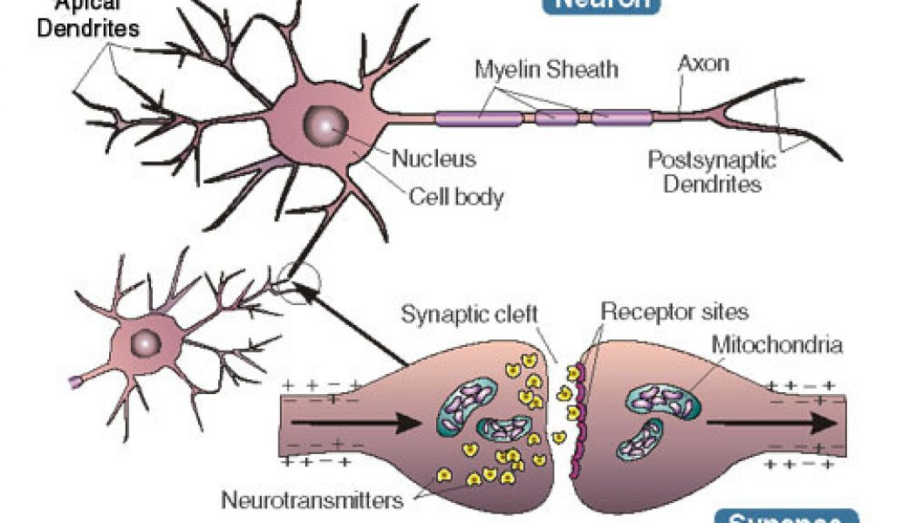
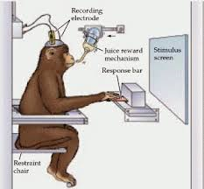
2. Neurochemical factors
A) 1960-1970: Monoamine theory of depression
In some occasions, depression = depletion of,
* Norepinephrine
* Serotonin
B) 1980: Such straight-forward mechanisms do not explain depression.
Actually, net increases in norepinephrine activity in depressive patients
Dopamine dysfunctions has an specific role in some forms of depression.
DA= > Involved in the experience of pleasure & reward
C) Nowadays: A number of integrative theories proposed to include a role for neurotransmitters in interaction with
At Presynaptical level
Within the synapse cleft
At postsynaptic level
- other disturbed hormonal
- neurophysiological patterns - biological rhythms

Slide 18
3. Abnormalities of hormonal regulatory and immune systems
Hypothalamic-pituitary-adrenal (HPA) axis
Periods of stress are typically associated with increased levels of both cortisol and corticotrophin-releasing factor.
Corticotrophin-releasing factor
corticotrophin
cortisol
In patients with major depression, the sensitivity of this negative feedback system is often decreased, leading to elevated levels
of cortisol.
Elevated cortisol also tend to show,
memory impairments and
problems with abstract thinking
complex problem solving.

Slide 19
4. Neurophysiological and neuroanatomical influences
OPFC is involved in responsivity to reward Depressed people show decreased volume in OPFC relative to normal controls
Decreased activity in the left DLPFC (EEG, fMRI, PET) is linked with depression
Amygdala (perception
of threat and in directing attention) tends to show increased activation in individuals with depression
Hippocampus (learning & memory)
Prolonged depression leads to decreased hippocampal volume.
Anterior Cingulate Cortex (selective attention, self-regulation and adaptability) shows decreased volume and abnormally low levels of activation in patients with depression

Slide 20
Psychological Causal Factors
Stressful life events
E.g. Loss of a loved one, serious threats to important close relationships or to one’s occupation, or severe economic or serious health problems.
Types of stressful life events:
- Independent life events: independent of the person’s behavior and
Personality (E.g. having one’s house hit by a huracane)
- Dependent life events: events that may have been at least partly generated by the depressed person’s behavior or personality ( (E.g. being unable to resolve conflicts with a spouse due to poor interpersonal problem solving).
Dependent life events play a stronger role in the onset of major depression than do independent life events

Slide 21
Different types of vulnerabilities for unipolar depression
Personality Diatheses
Neuroticism is the primary personality variable for depression & anxiety disorders
Neuroticism/negative affectivity: refers to a stable and heritable personality trait that involves a temperamental sensitivity to negative stimuli.
Predicts the ocurrence of stressful life events
Worse prognosis for complete recovery from depression
NOTE: High levels of introversion (or low positive affectivity) may also serve as vulnerability factors for depression.
Cognitive Diatheses
Regards “negative patterns of thinking”: people who attribute negative events to internal, stable, and global causes may be more prone to becoming depressed

Slide 22
Beck’s cognitive theory
(a diathesis-stress theory)
Dysfunctional beliefs develop during childhood and adolescence as a function of one’s negative experiences with one’s parents and significant others, and they are thought to serve as the underlying diathesis
….....................
Depressogenic schemas, which are rigid, extreme, and counterproductive
….....................
Creating a pattern of negative automatic thoughts that involve unpleasant, pessimistic predictions.
Predictions tend to center on the three themes the negative cognitive triad:
negative thoughts about the self
negative thoughts about one’s experiences and the surrounding world
(3) negative thoughts about one’s future

Slide 23
Negative cognitive triad tends to be maintained by a variety of negative cognitive biases or errors
● Dichotomous or all-or-none reasoning, which involves a tendency to think in extremes. “If I can’t get it 100 percent right, there’s no point in doing it at all”
● Selective abstraction, which involves a tendency to focus on one negative detail of a situation while ignoring other elements of the situation. “I didn’t have a moment of pleasure or fun today” not because this is true but because he or she selectively remembers only the negative things that happened.
● Arbitrary inference, which involves jumping to a conclusion based on minimal or no evidence. A depressed person might say, after an initial homework assignment from a cognitive therapist did not work, “This therapy will never work for me.”
Underlying negative beliefs ELICITS the Negative Cognitive Triad
REINFORCES The negative thinking

Slide 24
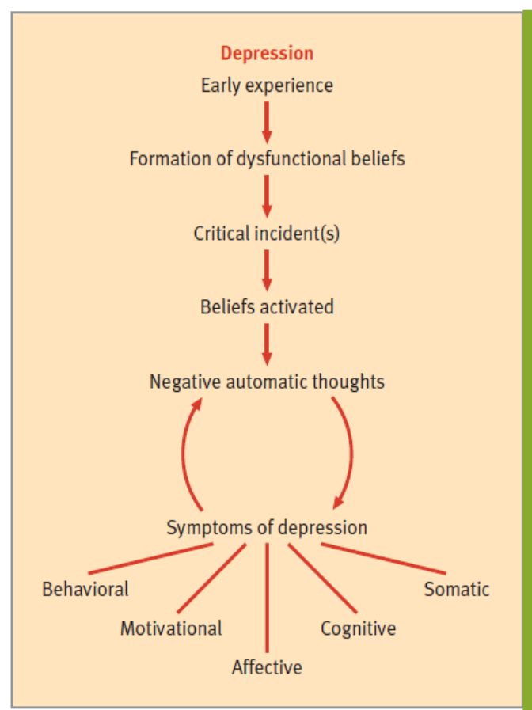
Recent research indicates that…
Stressful events are not NECESSARY to activate the latent depresive schemas
Induced depressed mood
Activate psychogenic schemas
Simply inducing a depressed mood in previously depressed people is enoght

Slide 25
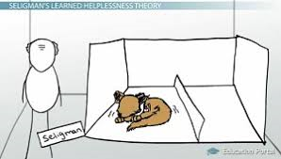
A theory generated from animal research…
Induced lack of control ever aversive events
Hopelessness
Unmotivated to cope with ANY aversive event
Slow to learn strategies
Negative cognitive set (humans)
The helplessness and hopelessness theories (Seligman, 1974)
https://study.com/academy/lesson/how-seligmans-learned-helplessness-theory-applies-to-human-depression-and-stress.html
Animals also show:
lower levels of aggression
loss of appetite and weight
changes in monoamine neurotransmitter levels

Slide 26
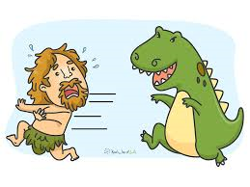
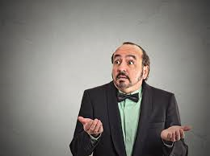
Research in humans lead to reformulate the hopelessness theory of Depression
In front of an adverse event,
humans ASK THEMSELVES, WHY?
The kinds of attributions DETERMINE whether they become depressed.
3 critical dimensions on which attributions are made:
internal/external (2) global/specific (3) stable/unstable
* Pessimistic attributional style + stressful life event Depression
*Hopelessness + Pessimistic attributional style + stressful event Depression
Hopelessness expectancy: the perception that one had no control over what was going to happen & by the absolute certainty that an important bad outcome was going to occur or that a highly desired good outcome was not going to occur (Abramson et al., 1989).
The relevant dimensions are the tendency to make negative inferences about:
- other likely negative consequences of the event
- the implications of the event for the self-concept

Slide 27
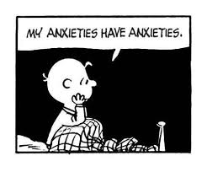
The Ruminative Response Styles Theory of Depression
When experiencing feelings and symptoms of sadness & distress, we may have different kinds of responses.
How different response styles affect the course of the depressed feelings???
Feelings -> Responses
RUMIATION:
A pattern of repetitive and relatively passive mental activity
People who rumiate, tend to have,
More lenghthy periods of depression
Increased recall of more negative autobiographical memories
Feeding vicious circle of depression
Action-oriented or problem-solving response to such feelings
E.g. distract themselves with another activity

Slide 28

High levels of critical and hostile comments (me or others) are related with depression relapses WHY?
Hooley and colleagues (2009) exposed healthy (never depressed) controls and women with a past history
of depression to critical remarks from their own mothers.
While they were lying in a brain scanner, each participant heard her own mother making personally relevant critical remarks.
Even though all the young women in the recovered-depressed group were completely well and had no symptoms of depression, their brains still responded differently from the healthy controls when challenged by criticism
Who are vulnerable to depression may be especially sensitive
to criticism even after they have made a full recovery.
Healthy
Healthy
Depressed
Children inherit/learn: temperament (including shyness, behavioral inhibition, and neuroticism), low levels of positive emotions, and poor ability to regulate emotions (factors for depression)

Slide 29
Bipolar Disorders
Bipolar disorders are distinguished from unipolar disorders by the presence of manic or hypomanic episodes, which are nearly always preceded or followed by periods of depression. Types:
Cyclothymic Disorder (cyclothymic patients are at greatly increased risk of later developing full-blown bipolar I or II disorder)
Down periods are very similar to “Dystimia” except for the duration criteria
Bipolar Disorder I: major depressive disorder + by at least one manic episode or mixed episode*.
* Mixed episode: characterized by symptoms of both full-blown manic and major depressive episodes for at least 1 week, whether the symptoms are intermixed or alternate rapidly every few days.
Bipolar Disorder II: Major depressive episodes + hypomanic episo.

Slide 30
Cyclothymic Disorder
Bipolar Disorder I
Bipolar Disorder II

Slide 31
Some statistics…
2-3% population
Gender: Equal in male than in female
Onset: starts at adolescence and young adulthood
Bipolar disorder I starts 5 years earlier (on average) than Bipolar disorder II.
Both are recurrent disorders, than can be seasonal: bipolar disorder with a seasonal pattern
5-10% of bipolar patients experience at least four episodes (either manic or depressive) every year, a pattern known as rapid cycling.
Recovery rate: 82% relapse within 7 years.

Slide 32
Cases…

Slide 34
Video: http://visual.pearsoncmg.com/ mypsychlababnormal/index.php?clipId=12
In Bipolar disorders the duration of manic and hypomanic episodes tends to be shorter than the duration of depressive episodes (x3 times)
Video: http://visual.pearsoncmg.com/mypsychlababnormal/index.php?clipId=12
Differential criteria:
People with a bipolar depressive episode tend, on average, to show more mood labililty, more psychotic features, more psychomotor retardation, and more substance abuse.
Individuals with unipolar depression, on average, show more
anxiety, agitation, insomnia, physical complaints, and weight loss.

Slide 35
Causal factors of Bipolar Disorders: Biological causal factors
Gene influence: Having a first-degree relative with bipolar disorder multiplies by 10 the chances to develop it.
Chromosomal site: genetic transmission is polygenic
The is a large genetic variability between “mania” and “depression”.
Neurochemical factors: norepinephrine, serotonin, and dopamine
are all involved in regulating our mood states. Disturbances in their balance seem to be one of the keys to understanding this ill.
Abnormalities of hormonal regulatory systems: Cortisol levels are elevated in bipolar depression but they are decreased during manic episodes.
Neurophysiological and neuroanatomical influences: PET, fMRI, EEG;
left prefrontal cortex activity is reduced during depression, during mania it is increased in certain other parts of the prefrontal cortex.

Slide 36
Psychological causal factors of Bipolar Disorders
Stressful life events: influence the timing of an episode, perhaps by activating the underlying vulnerability.
Other Psychological factors
Social environmental variables : low social support
Personality and cognitive variables: E.g. Neuroticism
Cognitive styles: cognitive
styles that are related to
goal-striving, drive, and
incentive motivation have
been associated with
bipolar disorder.

Slide 37
Treatments
Pharmacotherapy: Antidepressant:
Take 3-5 weeks to take effect
MAOIs- monoamine oxidase inhibitors MAO enzyme responsible for the break-down Norepinephrine & Serotonin
Tricyclic antidepresants (for severe cases)
Side effects:
  - dry mouth, constipation, sexual dysfunction & weight gain
  - highly toxic when taken in large doses (attempt to commit suicide)
- Selective serotonin reuptake inhibitor (SSRI): no more effective than the tricyclics but FEWER side effects and BETTER tolerated
- New atypical antidepresants (e.g. Bupropion). EVEN FEWER side effects
foods rich in the amino acid tyramine

Slide 38
Treatment with antidepressants is associated with significant risk of precipitating manic episodes or rapid cycling, although the risk of this happening is reduced if the person also takes lithium (mood stabilizer).
Lithium: both antimanic & antidepressant effects Effective in preventing cycling between manic & depressive episodes.
Side effects: lethargy, cognitive slowing, weight gain, decreased motor coordination, and gastrointestinal difficulties.
Patients who show signs of psychosis (hallucinations and delusions) may also receive treatments with antipsychotic medications.

Slide 39
Alternative Biological Treatments
Electroconvulsive therapy (ECT) https://www.youtube.com/watch?v=OK1XdXsb-Tw
Indications: severely depressed patients who may present an immediate and serious suicidal risk, who cannot take antidepressant medications or who are otherwise resistant to medications.
a complete remission of symptoms after about 6 to 12 treatments (with treatments administered about every other day).
The treatments, which induce seizures, are delivered under general anesthesia and with muscle relaxants
Immediate side effect is confusion,
lasting adverse effects on cognition, such as amnesia and slowed response time.
Effectivity: 80%

Slide 40
Transcranial magnetic stimulation (TMS)
- Treatment usually occurs 5 days a week for 2 to 6 weeks
Effectiveness: Comparable to unilateral ECT and antidepressants
Advantages: cognitive performance and memory are not affected adversely and sometimes even improve
Deep Brain Stimulation
Individuals with refractory depression right light therapy
https://www.youtube.com/watch?v=Jk0TGTdCXgQ
Bright light therapy
Originally used in the treatment of seasonal affective disorder, but it has now been shown to be effective in non-seasonal depressions.

Slide 41
Psycotherapy
Cognitive-Behavioral therapy (CTB)
10-20 sessions focused on “here-and-now” rather than in remote causal issues. Aims: - Evaluate systematically the dysfunctional beliefs and negative automatic thoughts - taught to identify and correct the biases or distortions in information processing - challenge their underlying depressogenic assumptions and beliefs
Behavioral activation treatment
Focuses intensively on getting patients to become more active and engaged with their environment and with their interpersonal relationships. E.g. scheduling daily activities, rating pleasure and mastery while engaging, exploring alternative behaviours…
Other: Mindfulness training, Interpersonal therapy or family and marital therapy.
Before ending… At least half never receive even minimally adequate treatment

Slide 42
SUICIDE

Slide 43
Overview
50-90% of those who complete the act do so during a depressive episode or in the recovery phase
Suicide is not associated with depression, it is still generally associated with some other mental disorder (borderline personality, conduct disorder, antisocial disorder)
Life prevalence: 3%
Psychosocial factors: personality traits as impulsivity, aggression, pessimism or negative affectivity, severe psychic anxiety, anhedonia, global insomnia, delusions and alcohol abuse.
Independent genetic vulnerability respect to the earlier diseases.
* Suicide attempts ratio (male: female) 1: 3 18-24 years old – drug ingestion
* Completed suicide more frequent in males: more frequently over 65 years old - Lethal methods (gunshot).
- Risk factors: substance abuse, antidepressants intake, Contagion/ imitation effects.

Slide 44
Is suicide a cultural fact?
What are the countries with the lowest suicide rate in Europe?
Spain, Italy, Greece and UK.
The greatest deterrent to committing suicide in times of personal stress is a sense of involvement and identity with other people

Slide 45
Prevention and Intervention
Most people who are depressed and contemplating suicide do not realize that their thinking is restricted and irrational and that they are in need of assistance.
They are more likely to visit a doctor’s office with multiple vague complaints of physical symptoms
Treatment:
antidepressant medication or lithium
Cognitive-behavioral therapy (feasible with adolescents)
Crisis interventions:
Primary objective is to help these people regain their ability to cope with their immediate problems as quickly as possible. Emphasis is usually placed on
maintaining supportive and often highly directive contact with the person over a short period of time—usually one to six contacts;
helping the person to realize that acute distress is impairing his or her ability to assess the situation accurately and to see that there are better ways of dealing with the problem; and
helping the person to see that the present distress and emotional turmoil will not be endless.

