Slide 1
Personality Disorders
Week 9

Slide 3
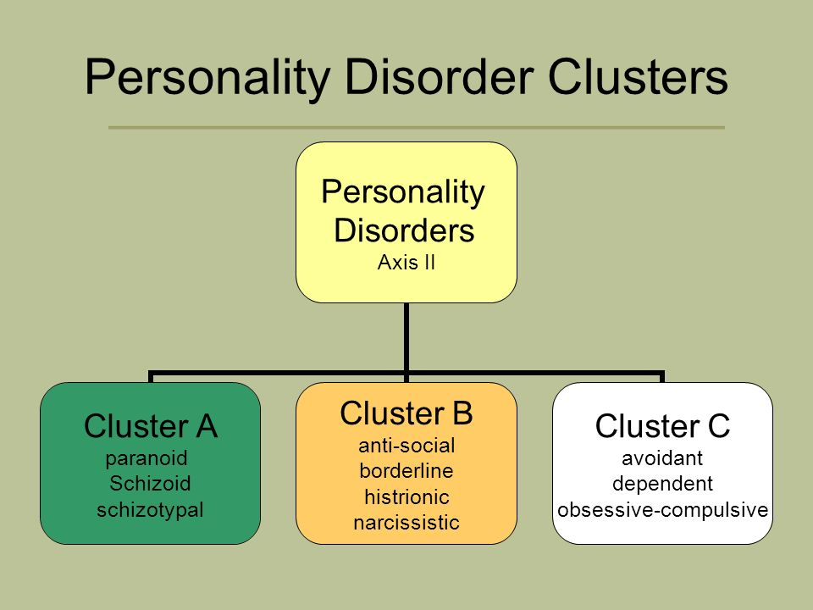

Slide 4
The 10 personality disorders movie
https://www.youtube.com/watch?v=p50Jpb9QB1k

Slide 5
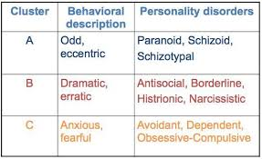
Personality Disorder

Slide 6
Cluster A: Personality Disorder
https://www.osmosis.org/learn/Cluster_A_personality_disorders

Slide 7
Cluster A: Paranoid Personality Disorder

Slide 8
Cluster A: Paranoid Personality Disorder

Slide 9
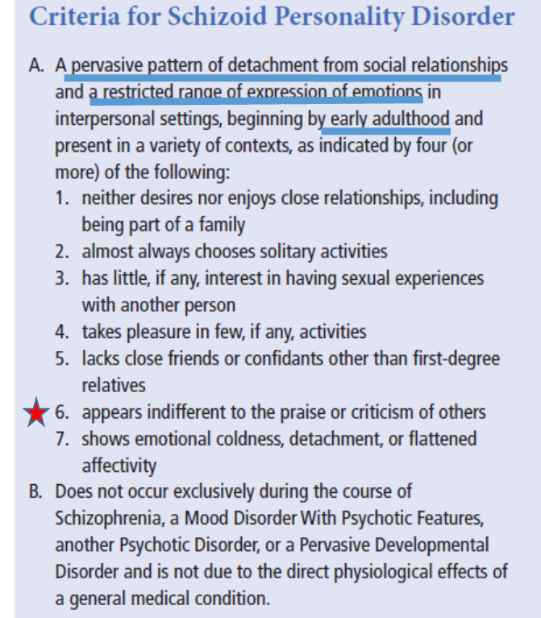
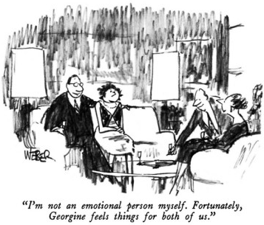
Cluster A: Schizoid personality disorder
- They are not emotionally reactive
- rarely experiencing strong positive or negative emotions, but rather show a generally apathetic mood.

Slide 10
Cluster A: Schizotypal personality disorder
Oddities in thinking, speech, and other behaviors are the
most stable characteristics of schizotypal personality disorder

Slide 11
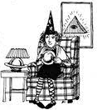
-
Ideas of reference: innocuous events or mere coincidences are taken as having strong personal significance.
- Similar genetic background as schizophrenia (shared cognitive impairments, e.g. working memory, attention, tracking)

Slide 12
Cluster B: Personality Disorders
Share a tendency to be dramatic, emotional, and erratic
https://www.youtube.com/watch?v=kdWnP8FReAI

Slide 15


Cluster B: Narcissistic Personality Disorder
They show,
an exaggerated sense of self-importance
a preoccupation with being admired,
a lack of empathy for the feelings of others
She said that part of her success could be attributed to her disorder.
https://www.youtube.com/watch?v=PuB_ng5uVaI&feature=youtu.be

Slide 16
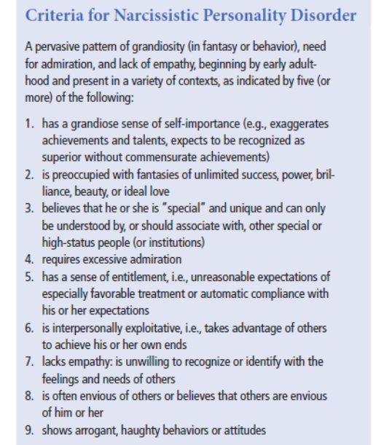

Slide 17
Cluster B: Antisocial Personality Disorder
https://www.youtube.com/watch?v=hzm-RsIzsuM

Slide 18
Cluster B: Borderline Personality Disorder
Show a pattern of behavior characterized by impulsivity and instability in interpersonal relationships, self-image, and moods.
http://visual.pearsoncmg.com/mypsychlababnormal/index.php?clipId=18#tab1

Slide 19
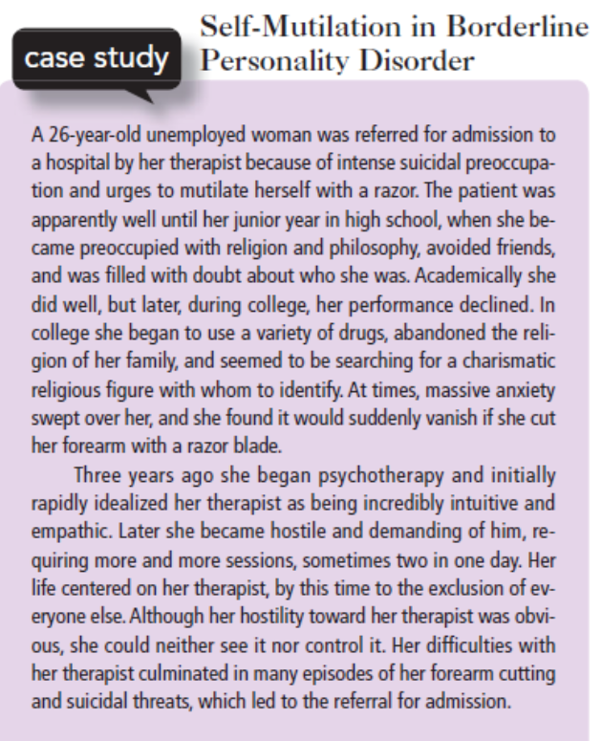

Slide 20
Cluster C: Personality Disorders
They often show anxiety and fearfulness, characteristics that we haven’t seen in the other two clusters.
https://www.osmosis.org/learn/Cluster_C_personality_disorders

Slide 21
Cluster C: Avoidant Personality Disorder
Avoidant personality disorder show extreme social inhibition and introversion, leading to lifelong patterns of limited social relationships and reluctance to enter into social interactions.

Slide 22
Cluster C: Dependant Personality Disorder

Slide 23
Cluster C: Obsessive-compulsive Personality Disorder

Slide 24
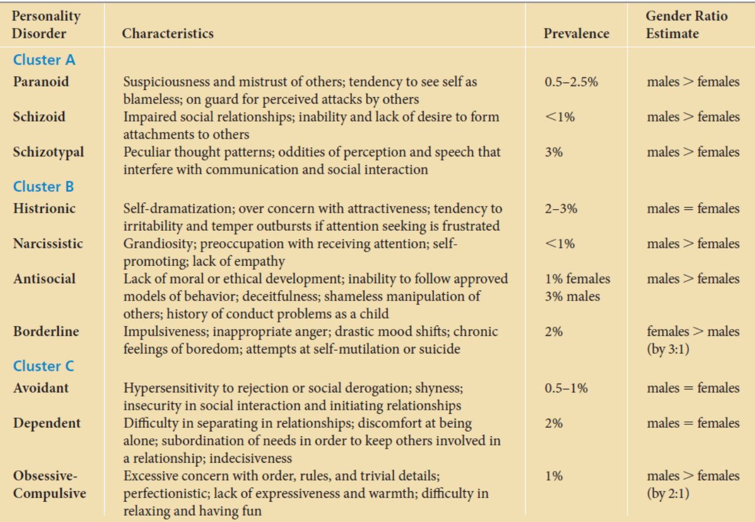
Summary
Suspicious, attacked by others, me=blameless
Cold, detached from others, no affected by critizisim, isolation
Oddities in perception and speech, magical thinking, innapropriate affect, lack of social relations, social anxiety.
Self-dramatization, need of being attractive to others, otherwise irritable
Grandiosity, self-promoting
Manipulation of others, lack of moral/laws, no empathy, no shame
Impulsivity, mood swifting, self-mutilation
Hypersensitivity to rejection, shyness, insecurity
Difficulty in separation, subordination to other´s needs, indecisiveness
Perfectionistic, detailed, concern on rituals, anxiety

