Slide 1

REMINDER
REVIEW

Slide 2
Sexual variants, abuse and dysfunctions
Week 9

Slide 3
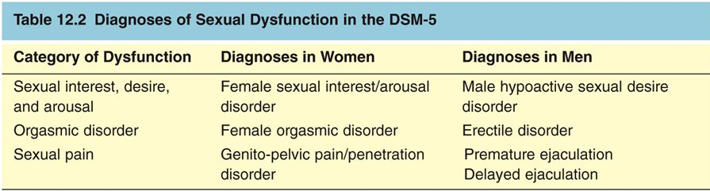
Content
Part I: Sexual variance - Paraphilias and Paraphilic Disorders
Part II: Sexual abuse

Slide 4
The paraphilias
Paraphilias: have recurrent, intense sexually arousing fantasies, sexual urges, or behaviors that generally involve
nonhuman objects
the suffering or humiliation of oneself or one’s partner,
children or other nonconsenting persons
Paraphilias are difficult to define from a clinical point of view because:
Some paraphilias are widely considered pathological even if the paraphilic individual does not experience distress.
E.g. a pedophile that does not feel guilty
Some categories of paraphilia may be compatible with psychological healthiness and happiness
E.g. A couple of foot fetishists

Slide 5
The paraphilias
Distinction between paraphilias vs. paraphilic disorders
- Paraphilias are unusual sexual interests, but they need not cause harm either to the individual or to others.
Paraphilic disorders: unusual sexual interests that causes harm.
E.g. two paraphilic patients, both with a fetish for women’s feet, but
only one of them is bothered by his erotic interest.
A paraphilic person is distinguished by,
the insistence,
the relative exclusivity with which his/her sexuality focuses on the acts or objects in question.
Furthermore: Compulsive quality & may/may not have desires to change
Prevalence: ?
Gender ratio: 8:1 or 5:1

Slide 6
DSM-IV recognizes eight specific paraphilias:
fetishism
transvestic disorder
(3) Voyeurism
(4) Exhibitionism
(5) sexual sadism
(6) sexual masochism
(7) Pedophilia
(8) Frotteurism: rubbing one’s genital area against a nonconsenting person
An additional category (Non otherwise specified paraphilias)
Several paraphilias tend to occur together.

Slide 7
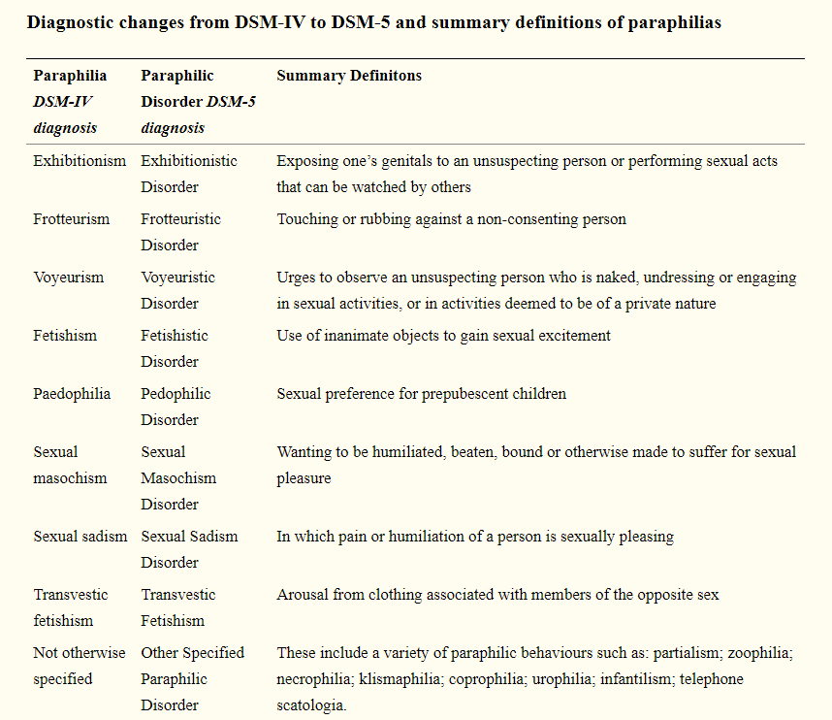

Slide 8
NOS sexual desire/interest/arousal…
Partialism (… with a focus on a specific part of the body: hair, breasts or feet –podophilia-)
Telephone scatologia (obscene phone calls)
Necrophilia (… for corpses)
Zoophilia (… in animals)
Coprophilia (… to feces)
Klismaphilia (… from enemas)
Urophilia (… from the sight or thought of urine or urination)
Infantilism: it involves role-playing a regression to an infant-like state -drinking from a bottle or wearing diapers-).

Slide 9

FETISHISTIC DISORDERS
Intense sexually arousing fantasies, urges, and behaviors involving the use of some inanimate object or part of the body non typically found erotic to obtain sexual gratification.
BUT, e.g. High heels-lovers do not typically meet diagnostic criteria for fetishism because the paraphernalia are not necessary or strongly preferred for sexual arousal.
The excitement and suspense of the criminal actitself tipically reinforce the sexual stimulation and, sometimes, constitute the fetish.

Slide 10

TRANSVESTIC DISORDER
Heterosexual men who experience recurrent, intense sexually arousing fantasies, urges, or behaviors that involve cross-dressing as a female.
BUT Although some gay men dress “in drag” on occasion, they do not typically do this for sexual pleasure and hence are not transvestic disorder.
Begining: during adolescence and involves masturbation while wearing female clothing or undergarments.
Psychological motivation of many transvestites includes autogynephilia: paraphilic sexual arousal by the thought or fantasy of being a woman.
Predicts gender dysphoria and desire for sex reassignment surgery

Slide 11
VOYEURISTIC DISORDER
Regards recurrent, intense sexually arousing fantasies, urges, or behaviors involving the observation of unsuspecting females who are undressing or of couples engaging in sexual activity.
Voyeurism often co-occurs with exhibitionism, and it is also associated with interest in sadomasochism and cross-dressing.
Voyeuristic activities often provide important compensatory feelings of power and secret domination (avoiding to cope with a meeting situation) over an unsuspecting victim, which may contribute to the maintenance of this pattern.
A large Swedish survey (2,400 men & women) found that
- 11.5 %of the men
- 3.0 % of the women had at some time engaged in voyeuristic activity

Slide 12
EXHIBITIONISTIC DISORDER
Recurrent, intense urges, fantasies, or behaviors that involve exposing his genitals to others (usually strangers) in inappropriate circumstances and without their consent.
The element of shock in the victim is
highly arousing to these individuals
Victims: ordinarily, a young or middle-aged female who is not known to the offender, although children & adolescents may also be targeted
It usually begins in adolescence or young adulthood.
It is the most common sexual offense reported to the police in the USA, Canada and Europe
Exhibitionism is associated with greater psychological problems, lower life satisfaction and greater use of pornography.

Slide 13
FROTTEURISTIC DISORDER
Sexual excitement at rubbing one’s genitals against, or touching, the body of a nonconsenting person.
It commonly co-occurs with voyeurism and exhibitionism.
SEXUAL SADISM DISORDER
Recurrent, intense sexually arousing fantasies, urges, or behaviors that involve inflicting psychological or physical pain on another individual.
The pain inflicted by sadists may come from whipping, biting, cutting, or burning.
Prevalence: 5-15% men & women enjoy sadistic and/or masochistic activities voluntarily on occasion
http://visual.pearsoncmg.com/mypsychlababnormal/index.php?clipId=20#tab1

Slide 14
MASOCHISM DISORDER
A person experiences sexual stimulation and gratification from the experience of in relating to a lover by being humilliated, beaten, pain and degradation, or bound, often in a ritualistic pattern of behavior.
Masochism appears to be more common than sadism and occurs in both men and women.
One particularly dangerous form of masochism
called autoerotic asphyxia
involves self-strangulation
(“accidental death” occurs between 500-1000/year in USA)

Slide 15
General characteristics of paraphilias
First, nearly all persons with paraphilias are male. When occasionally found in women, the most likely ones are pedophilia (being aroused by prepubescent boys), sadomasochistic activities, and exhibitionism.
Second, paraphilias usually begin around the time of puberty or early adolescence.
Third, people with paraphilias often have a very strong sex drive, with affected men often masturbating many times a day.
Fourth, people with paraphilias frequently have more than one. For example, the corpses of men who died accidentally in the course of autoerotic asphyxia were partially or fully cross-dressed in 25 to 33 percent of cases.

Slide 16

PART II: Sexual abuse
Sexual contact that involves physical or psychological coercion or at least one individual who cannot consent to the contact.
Includes: - pedophilia (the only one included in DSM-V) - Incest - Rape
Why just pedophilia is included in DSM-V?
Are incest/rape mental disorders or criminals acts?

Slide 17
Child abuse
Why is relevant to pay attention to child abuse in Abnormal psychology?
Abuse may be important in the etiology of some disorders
Childhood sexual abuse is more common than was once assumed and it is important to understand some of its causes
Controversial issues such as the validity of children’s testimony and the accuracy of recovered memories of sexual abuse
PREVALENCE:
7.9% Men
19,7% women have been abused before 18 years old

Slide 18
Consequences of chilhood sexual abuse
Short-term consequences:
Fears
posttraumatic stress disorder
sexual inappropriateness (e.g., touching others’ genitals or talking about sexual acts)
poor self-esteem
NOTE: approximately 1/3 of sexually abused children show no symptoms
Long-term consequences: Adult psychopathology
Borderline personality disorder
Somatization disorder and disociative symptoms
Sexual symptoms (from sexual aversion to sexual promiscuity)

Slide 19
1) Pedophilia
An adult has recurrent, intense sexual urges or fantasies about sexual activity with a prepubertal child; Note: pubescence: 10-13years old.
Pedophilia is defined by the body maturity, not the age, of the preferred partner.
Child molester more likely engaged in self-justifying cognitive distortions, including the beliefs that children will benefit from sexual contact with adults and that children often initiate such contact.
Pedophilia usually begins in adolescence and persists over a person’s life.
Pedophilus characteristics:
have lower IQ
higher rates of head injuries resulting in loss of consciousness
differences in brain structure detected by brain-imaging techniques

Slide 20
2) Incest
Sexual relations between family members.
https://www.youtube.com/watch?v=vj05Q-wcQiE
Incestuous child molesters tend to have some pedophilic arousal patterns
BUT,
  the large majority of incest offenses are against girls,
  they are more likely to offend with only 1 or a few children in a family

Slide 21
3) Rape
Statutory rape is sexual activity with a person who is legally defined to be under the age of consent (18 in most states) even if the underage person consents.
IS RAPE MOTIVATED BY SEX OR AGGRESSION?
1) Need to dominate, to assert power, and to humiliate a victim rather than by sexual desire for her
2) There are many compelling reasons why sexual motivation is often, if not always, a very important factor too (Bryden & Grier, 2011):
Distribution per ages (different from other crimes)
Reports of sexual motivation as a very important cause
Rapists ussually exhibit other paraphilias (exhibitionism, voyeurism)

Slide 22
RAPISTS AND CAUSAL CONSIDERATIONS
Characteristics (different from date-rapists)
Around 25 years old (60%)
30-50% are married and living with their wives at the time of the crime
- Come from the low end of the socioeconomic ladder
Commonly have a prior criminal record
Higher levels of impulsive, antisocial behavior, insensitivity to social cues
Quite likely they have experienced in childhood
  sexual abuse,
  a violent home environment
  inconsistent caregiving

Slide 23
Treatment of recidivism of sex offenders
Sex offenders with deviant sexual preferences (e.g., exhibitionists, severe sadists, and those who are most attracted to children) have particularly high rates of sexual recidivism.
Psychotherapy – goals:
to modify patterns of sexual arousal (By aversion therapy)
To modify cognitions and social skills to allow more appropriate sexual interactions with adult partners,
to change habits or behavior that increases the chance of reoffending,
to reduce sexual drive
Biological and surgical treatments:
- Chemical castration lower the testosterone level, which in turn lowers the sex drive-→ high relapse rated upon discontinuation
- Surgical castration: 3% recidivism

Slide 24
Gender dysphoria
DSM-V aims to avoid stigma and ensure clinical care for individuals who see and feel themselves to be a different gender than their assigned gender. It replaces the diagnostic name “gender identity disorder” with “gender dysphoria,” as well as makes other important clarifications in the criteria.

Slide 25
The end…

