Slide 1
Schizophrenia (Part I)
Week 10

Slide 3
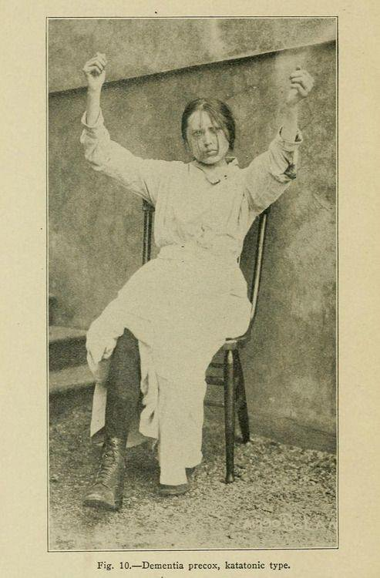
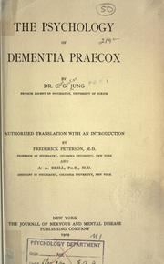
The hallmark of schizophrenia is psychosis:
a significant loss of contact with reality
Origins of the construct:
John Haslam (-1800- Bethlem Hospital in London)
The first patient description of what we call today schizophrenia
Emil Kraepelin carefully described what we now regard as schizophrenia (dementia praecox: mental deterioration early in life)
Eugen Bleuler used schizophrenia
(from the Greek roots of sxizo,
meaning “to split or crack,”
and phren, meaning “mind”)

Slide 4
Epidemiology
Life-prevalence < 1%
People at higher risk of developing schizophrenia:
Older parents (45-50 years-old) at their birth -> 2-3 times more risk
Parents who work as a dry cleaner (And organic solvents used in the dry cleaning business might disrupt fetal neurodevelopment
Afro Caribbean people living in the UK
Beggining: late adolescence & early adulthood (earlier in men)
Gender ratio 1.4:1
More severe forms in males
Late-onset pattern in women is associated with a more severe clinical presentation

Slide 5
Delusions are deemed bizarre if they are clearly implausible and not understandable to same-culture peers and do not derive from ordinary life experiences. An example named by the DSM-5 is a belief that someone replaced all of one's internal organs with someone else's without leaving a scar.

Slide 6
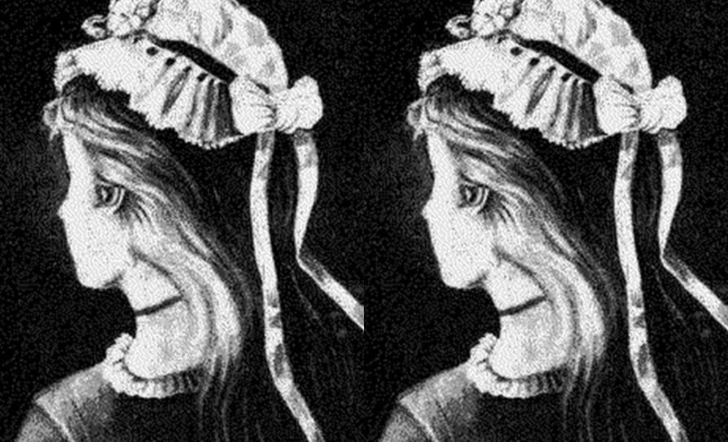
Delusions

Slide 7


Slide 8
1. Delusions or false beliefs
An erroneous belief that is fixed and firmly held despite clear contradictory evidence (in 90% of patients)
Regards THE CONTENT of the thought
Types:
One’s thoughts, feelings, or actions are being controlled by external agents (made feelings or impulses)
One’s private thoughts are being broadcast indiscriminately to others (thought broadcasting)
One´s thoughts are being inserted into one’s brain by some external agency (thought insertion)
Some external agency has robbed one’s thoughts (thought withdrawal)
Some neutral environmental event (such as a television program or a song on the radio) is believed to have special and personal meaning intended only for the person (delusions of reference)

Slide 9
2. Hallucinations
A sensory experience that seems real to the person having it, but occurs in the absence of any external perceptual stimulus.
Regards THE CONTENT of the thought
Types: in any sensory modality Auditory, visual, olfactory, tactile, or gustatory
Auditory hallucinations are the most common (even in deaf patients)
https://www.youtube.com/watch?v=POwRthssVaI
Are patients who are hallucinating really hearing voices?

Slide 10
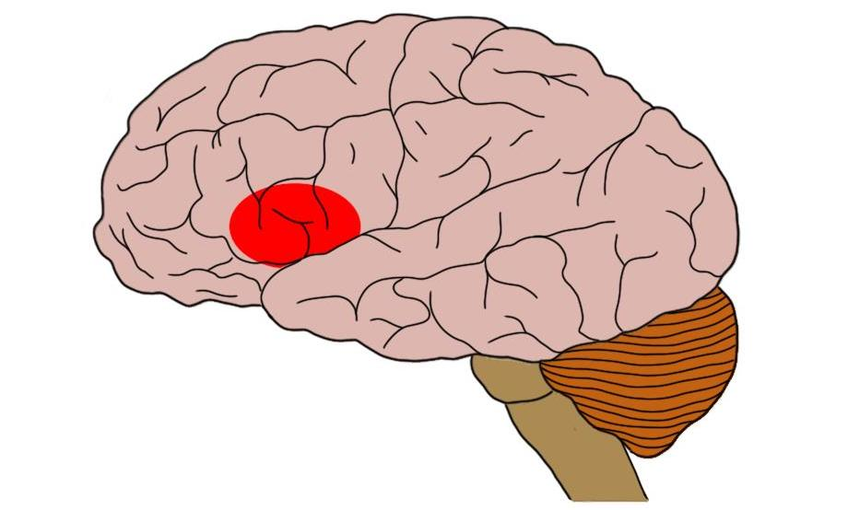
Are patients who are hallucinating really hearing voices?
Neuroimaging studies (PET and fMRI) reveal that,
Hallucinating patients show increased activity in Broca’s area —an area of the temporal lobe that is involved in speech production.
The pattern of brain activation that occurs when patients experience auditory hallucinations is very similar to that seen when healthy volunteers are asked to imagine that there is another person talking to them.
Misinterpretation of their own self-generated & verbally mediated thoughts?
speech production

Slide 12
3. Disorganized Speech and Behavior
A failure to make sense, despite seeming to conform to the semantic and syntactic rules governing verbal communication (including neologisms)
Formal though disorder: problems in the way that disorganized thought is expressed in disorganized speech
Regards thought FORM

Slide 13
… Desorganized behaviour
- Goal-directed activity is almost universally disrupted in schizophrenia.
- The impairment occurs in areas of routine daily functioning, such as work, social relations, and self-care (e.g. Unusual dress).

Slide 14
Catatonia stupor: virtual absence of all movement and speech

