Slide 1
Disorders in childhood
Week 11

Slide 2
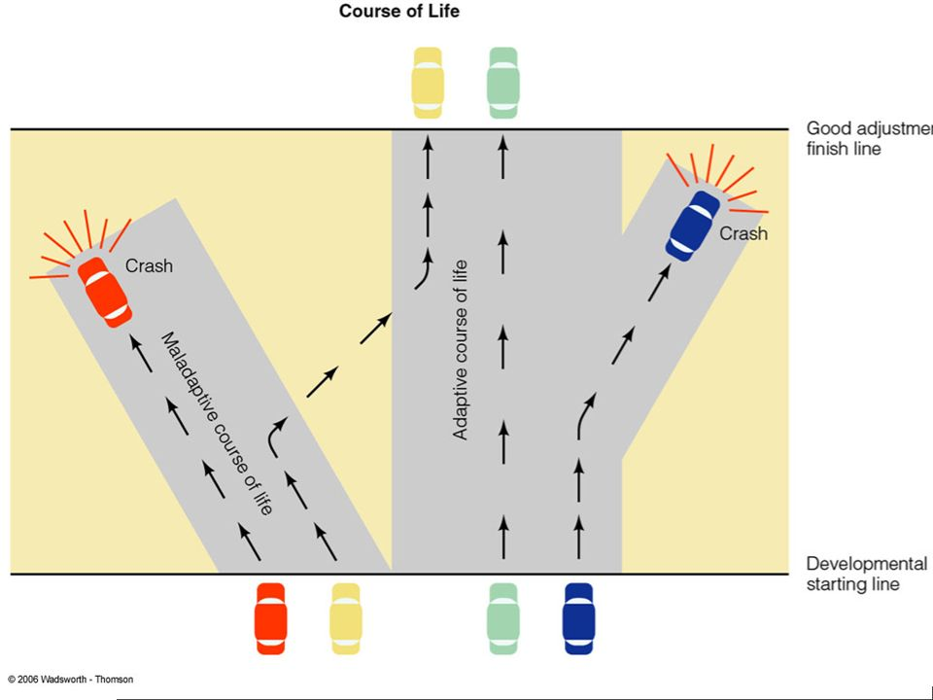
Until the twentieth century, little account was taken of the special
characteristics of psychopathology in children.
* The prevailing view was one of children as “miniature adults.”
Developmental psychopathology studies the origins and course of
individual maladaptation in the context of normal growth processes.
Prevalence: 12.3%
The most prevalent ones are,
  attention-deficit/hyperactivity disorder
  separation anxiety disorders

Slide 3
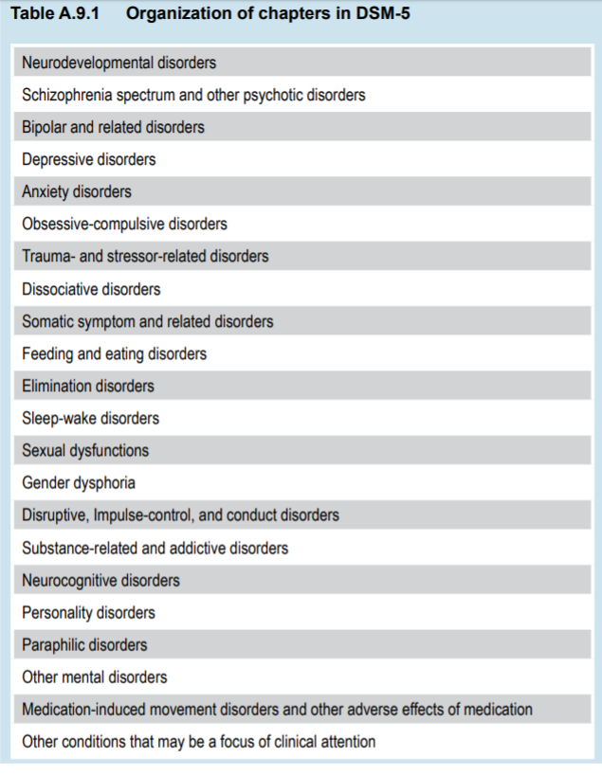
The Classification of Childhood and Adolescent Disorders
DSM-I (1952) included only two childhood emotional disorders: childhood schizophrenia and adjustment reaction of childhood
DSM-V (2013) ------->

Slide 4
Attention-Deficit/Hyperactivity Disorder (ADHD)
Characterized by difficulties that interfere with effective task-oriented behavior in children—particularly
* impulsivity
* excessive or exaggerated motor activity such as aimless or haphazard running or fidgeting
* difficulties in sustaining attention.
Prevalence: 8% in USA
ADHD children are not anxious, even though their over activity, restlessness, and distractibility are frequently interpreted as indications of anxiety.
* Specific learning disabilities: difficulties in reading or in learning other basic school subjects

Slide 5
QUIZ: https://www.youtube.com/watch?v=-IO6zqIm88s
Treatments
Ritalin (anphetamines) decreases averactivity and distractibility, as well as increasing alertness.
Side effects:
- decreased blood flow to the brain (impaired thinking) - disruption of growth hormone (suppression of growth in body and brain)
- insomnia
- psychotic symptoms
Strattera (Atomoxetine, NA precursor): Reduces symptoms of ADHD
Side effects: decreased appetite, nausea, vomiting and fatigue

Slide 6
Oppositional Defiant Disorder and Conduct Disorder
A recurrent pattern of negativistic, defiant, disobedient, and hostile behavior toward authority figures, repetitive violation of rules and a disregard for the rights of others that persists for at least 6 months
Beginning: age of 8
Risk factors: family discord, socioeconomic disadvantage, and antisocial behavior in the parents.
Traits: overt or covert hostility, disobedience, physical and verbal aggressiveness, quarrelsomeness, vengefulness, and destructiveness, Lying, solitary stealing, sexually uninhibited, sexual aggression, cruelty to animals, vandalism, bulling or robbery.
Treatment: antidepressant medication (Prozac) behavior therapy (to child & parents)

Slide 7
3. Anxiety and Depression
Anxiety characteristics: oversensitivity, unrealistic fears, shyness and timidity, pervasive feelings of inadequacy, sleep disturbances, and fear of school
Prevalence: 5-10%
Depression includes behaviors
such as
withdrawal, crying, avoidance
of eye contact, physical
complaints, poor appetite
and even aggressive behavior.

Slide 8
4. Symptom Disorders
Enuresis: primary functional vs secondary functional
Encopresis: children who have not learned appropriate toileting for bowel movements after age 4.
Sleepwalking: repeated episodes in which a person leaves his or her bed and walks around without being conscious of the experience or remembering it later.
  In 2nd or 3rd hour of sleep
  In NO-REM
Tics: is a persistent, intermittent muscle twitch or spasm, usually limited to a localized muscle group.
Tourette’s disorder is an extreme tic disorder involving multiple motor and vocal patterns

Slide 9
5. Pervasive Developmental disorders (Autism, Asperger,…)
Autism: Developmental disorder that includes deficits in language & perceptual and motor development and an inability to function in social situations.
“Autistic children seem apart or aloof from others”
- Babies never being cuddly,
- never reaching out when being picked up, - never smiling or looking at them while being fed, - never appearing to notice the comings and goings of other people

Slide 10
Autism spectrum disorders
Characterized by delays in the development of multiple basic functions including socialization and communication.
Prevalence: 3.2%
PDD-NOS (Pervasive Developmental Disorder – Non specified): children or adults who are on the autism spectrum but do not fully meet the criteria for another ASD.

Slide 11
THE CLINICAL PICTURE IN AUTISTIC DISORDER
VIDEO: https://www.youtube.com/watch?v=z7NeBs5wNOA&t=331s
Social Deficits:
- Children express emotions BUT show a LACK OF SOCIAL UNDERSTANDING
- Have deficits in attention & in location/orienting in the environment
* An absence of Speech or Echolalia (parrot-like repetition of words)
* Self-stimulation by repetitive movements as head banging, spinning, and rocking, which may continue by the hour
* Intellectual Ability: Problems on memory, in representing mental, symbolic tasks (e.g. pantomime with imagined objects).
- Some of them are highly skilled at fitting objects together (puzzles)
* Maintaining Sameness: - To be “obsessed with the maintenance of sameness” - Strong attachments to unusual objects such as rocks, light switches, or keys

Slide 12
Asperger´s Disorders
Characteristics:
Social impairment disorders
Restricted interest
Repetitive behaviors
striving to maintain sameness
physical awkwardness
BUT appears later than autism & is not associated with the severe delay in language development and social interactions
MAIN Characteristic:
* Impairment of interpersonal interactions, including impairment of facial expressions, body postures, and gestures
Fail to develop peer relationships

Slide 13
6. Learning Disabilities
Delayed development in language, speech, mathematical, or motor skills, and it is not due to any reliably demonstrable physical or neurological defect.
E.g.
- dyslexia: problems in word recognition and reading comprehension; deficient in spelling and memory.
At reading, these persons routinely omit, add, and distort words, and their reading is typically painfully slow.
They don´t show obvious
emotional problems, lack of
cooperativeness or eagerness
to please teachers and parents.

Slide 14
FIN

