Slide 1
Abnormal Psychology
Spring 2020
Prof Cristina Nombela Otero
Week 1
Monday, January 3rd 2020

Slide 2
The textbook of Abnormal Psychology
Butcher, J.N., Mineka, S., Hooley, J.M. (2013). Fundamentals of Abnormal Psychology and Modern
Life, 15th ed. New Jersey, Pearson Education

Slide 5
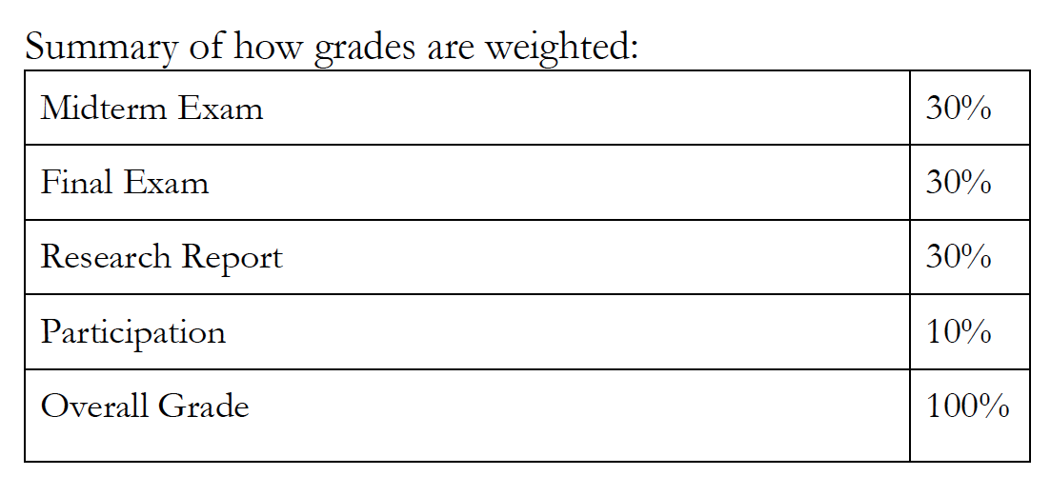
The Evaluation of Abnormal Psychology
Exams + Research report + Participation

Slide 6
The Evaluation of Abnormal Psychology
Midterm Exam – mixed format including objective-type questions and essays.
2. Final Exam – mixed format including objective-type questions and essays.
3. Report & Presentation – Students will prepare an 8-10 page paper on a topic chosen by the professor and give a 10 minute presentation of their report to the class.
4. Class Participation – Criteria will be discussed in class.

Slide 7
Essay structure
Maximun 9 pages (all pages included).
Page 1: Indicate name and essay title on top of the page
Page 2: Index
Page 3: Abstract
Page 4—5-6-7: Content
What are you presenting?
Why is this relevant?
Analysis of the topic: what points compound your topic? Describe each of the components and, at the end, the relation between them.
Page 8: Conclusions: Based on what you have written, what are your feelings regarding the topic. Is there any way of approaching it? Any treatment?
Page 9: Reference list (following the same format for all references)

Slide 8
Regarding the presentation
Slide 1: Name and tittle
Slide 2: Index
Slide 3: Introduction: What is the info available regarding your topic?
Slide 4-5: Content (aspects analysed)
Slide 6: Conclusions
Slide 7: END

Slide 9

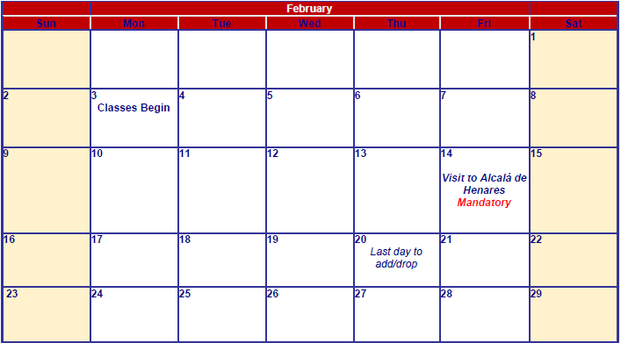
The calendar of Abnormal Psychology

Slide 10
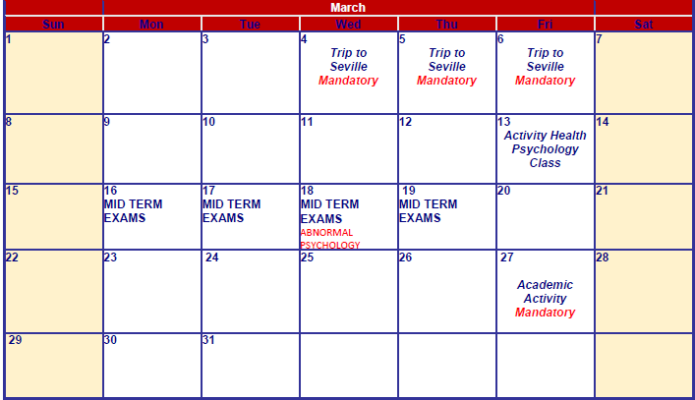
The calendar of Abnormal Psychology

Slide 11
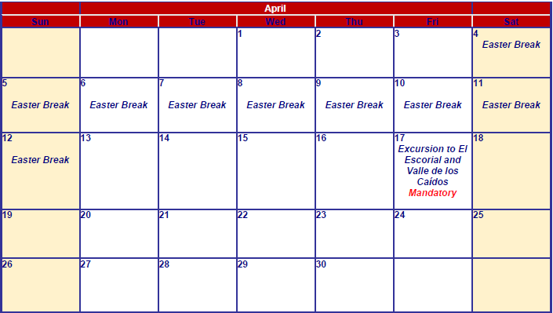
The calendar of Abnormal Psychology
8.45am
8.45am
Presentations
8.45am

Slide 12

The calendar of Abnormal Psychology
Abnormal
Psychology
Exams Review

Slide 13
And now, your turn…
What´s your name?
Where are you from?
What´s your background?
Why did you choose (if you don´t drop off) this subject?
What do you expect?

Slide 14
What is abnormal psychology?
Give me a definition, please
What do we study at Abnormal psychology?

Slide 15
Abnormal psychology is concerned with understanding
the nature,
causes,
and treatment
of mental disorders

Slide 16
What are you most interested in learning about?
What interests you the most?

